Slide 1
GROSS ANATOMY OF THE PANCREAS
BY
DR A.O OJEWALE

Slide 2
OUTLINE
INTRODUCTION
LOCATION
SIZE & SHAPE
PARTS
RELATIONS
DUCTS
BLOOD SUPPLY
APPLIED ANATOMY

Slide 3
PANCREAS (Intro’)
The pancreas is a soft, finely lobulated organ, elongated exocrine-endocrine gland. The exocrine part secretes the pancreatic juice and the endocrine part secretes the hormones (insulin).
The pancreatic juice helps in the digestion of lipids, carbohydrates, and proteins, whereas the pancreatic hormones maintain glucose homeostasis.

Slide 4
LOCATION OF THE PANCREAS
It lies horizontally on the posterior abdominal wall in the epigastric and left hypochondriac regions. It crosses the posterior abdominal wall obliquely from concavity of the duodenum to the hilum of spleen opposite the level of T12–L3 vertebrae. The greater part of the gland is retroperitoneal behind the serous floor of the lesser sac. Its left extremity-the tail, lies in the lienorenal ligament.

Slide 5
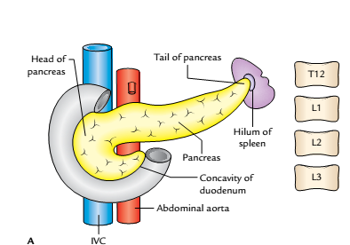
Location of the pancreas: A, head lies opposite L1 and L3 vertebrae, body lies more or less in transpyloric plane (lower border of L1), and tail is at the level of T12 vertebra.

Slide 6
SIZE AND SHAPE
The pancreas is “J”-shaped or retort shaped being set obliquely. The bowl of retort represents its head and the stem of retort represents its neck, body, and tail. Its measurements are:
Length:12-15 cm.
Width:3-4 cm.
Weight: 80-90 g.

Slide 7
PARTS (SUBDIVISIONS) AND RELATIONS
The pancreas is subdivided into four parts:
Head (with one process-uncinate process).
Neck.
Body (with one process-tuber omentale).
Tail.

Slide 8
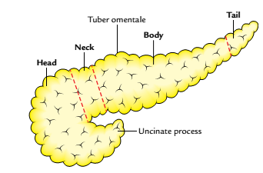
HEAD OF THE PANCREAS
It is the enlarged, disc-shaped right end of the pancreas, which lies in the concavity of the C-shaped duodenal loop in front of the L2 vertebra.
Parts of the pancreas

Slide 9
Cont’d
External Features
It presents the following external features:
Three borders: Superior, inferior, and right lateral.
Two surfaces: Anterior and posterior
One process: Uncinate process (It is a hook-like process from the lower and left part of the head of the pancreas. It extends toward the left behind the superior mesenteric vessels).

Slide 10
Relations
Superior border is related to:
First part of the duodenum, and
Superior pancreaticoduodenal artery.
Inferior border is related to:
Third part of the duodenum, and
Inferior pancreaticoduodenal artery.
Right lateral border is related to:
Second part of the duodenum, and
Anterior and posterior pancreaticoduodenal arterial arcades.

Slide 11
Cont’d
Anterior surface is related from above downward to: (a) gastroduodenal artery, (b) transverse colon, (c) root of the transverse mesocolon, and (d) jejunum.
Posterior surface is related to: (a) IVC, (b) left renal vein, (c) bile duct (lying in a groove, and may be found embedded in the pancreatic tissue), and (d) right crus of diaphragm.
Uncinate process is related to: (a) anteriorly to superior mesenteric vessels, and (b) posteriorly to the abdominal aorta.

Slide 12
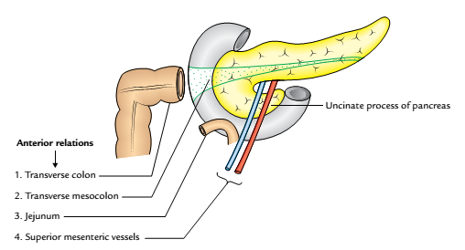
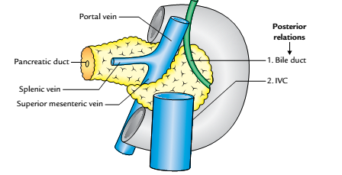
Cont’d
A
B
Relations of the head of pancreas: A, anterior relations; B, posterior relations

Slide 13
NECK OF THE PANCREAS
It is a slightly constricted part of the gland which connects the head with the body. It is about 2.5 cm (1 inch) long and is directed forward, upward, and to the left.
External features
Two surfaces: Anterior and posterior.
Two borders: Upper and lower.

Slide 14
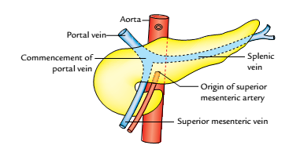
Relations
Anterior surface is related to pylorus.
Posterior surface is related to commencement of the portal vein.
Upper border is related to the first part of the duodenum.
Lower border is related to the root of the transverse mesocolon
Relations of the neck of pancreas

Slide 15
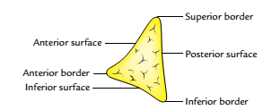
BODY OF THE PANCREAS
It is the elongated part of the gland extending from its neck to the tail.
It passes toward the left of midline with a slight upward and backward inclination.
It lies in front of the vertebral column at or just below the transpyloric plane.
Surfaces and borders of the body of pancreas as
seen in cross section

Slide 16
External Features
It is triangular in cross section and presents:
1. Three borders: Anterior, superior, and inferior.
2. Three surfaces: Anterior, posterior, and inferior.
3. One process: Tuber omentale (a part of the body projects above the lesser curvature of the stomach and comes in contact with the lesser omentum across the lesser sac).

Slide 17
Relations
Anterior border provides the attachment to the root of transverse mesocolon.
Superior border is related to the coeliac artery above the tuber omentale, hepatic artery to the right, and splenic artery to the left of tuber omentale.
Inferior border is related to superior mesenteric vessels (at its right end).
Anterior surface (concave and directed forward and upward) is related to:(a) lesser sac, and (b) stomach.

Slide 18
Cont’d
Posterior surface (devoid of peritoneum) is related to:
aorta and origin of the superior mesenteric artery,
left kidney and left suprarenal glands, and
splenic vein usually lies in a groove below the level of splenic artery.
Inferior surface (covered by peritoneum) is related to: (a) duodenojejunal flexure, (b) coils of jejunum, and(c) left colic flexure.

Slide 19
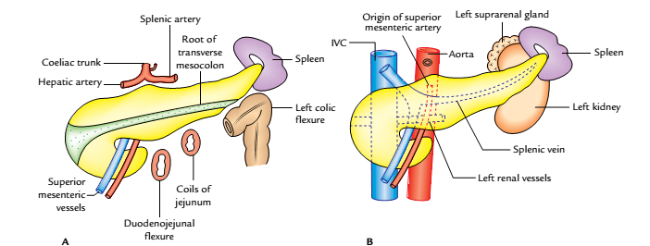
Relations of the body of pancreas: A, anterior and inferior relations; B, posterior relations

Slide 20
TAIL OF THE PANCREAS
It is the narrow left extremity of the pancreas.
It lies in the lienorenal ligament along with splenic vessels.
It is mobile unlike the other major retroperitoneal parts of the gland.
It contains the largest number of islets of Langerhans per unit of tissue as compared to other parts of the gland.

Slide 21
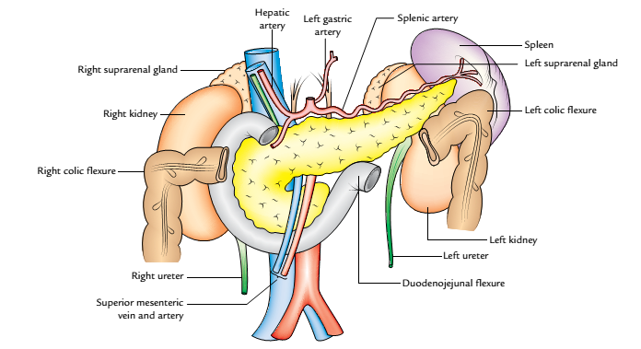
Relations
These are related to the visceral surface of spleen between gastric impression and colic impression.
The visceral relations of the different parts of pancreas are shown below.
Visceral relations of the different parts of the pancreas

Slide 22
DUCTS OF THE PANCREAS
There are two ducts usually: main and accessory, which drain the exocrine secretion into the duodenum.
MAIN PANCREATIC DUCT
It begins in the tail and traverses the whole length of the gland near its posterior surface.
At the neck, it turns downward, and then to the right to enter into the second part of duodenum.

Slide 23
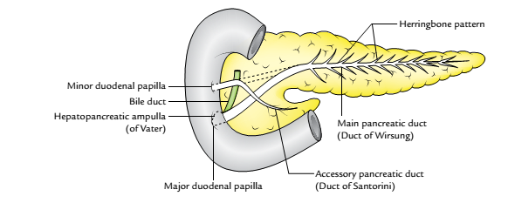
Cont’d
It joins the bile duct as it pierces the duodenal wall to form the hepatopancreatic ampulla (of Vater) which opens by a narrow mouth on the summit of major duodenal papilla 8-10 cm distal to the pylorus.
Pancreatic ducts

Slide 24
Cont’d
It receives tributaries (smaller ducts) throughout its length, at right angle to its long axis in a “herringbone pattern.”
It is the only duct in 90% of cases.

Slide 25
ACCESSORY PANCREATIC DUCT
It begins in the lower part of the head, and then runs upward and medially, crossing in front of main pancreatic duct.
It opens into the second part of the duodenum on the summit of minor duodenal papilla about 2-3 cm above the opening of main pancreatic duct (6-8 cm distal to pylorus).
In 40% of cases, it communicates with the main duct while crossing it.

Slide 26
ARTERIAL SUPPLY
The pancreas is a high vascular structure and supplied by the following arteries:
Splenic artery, is a branch of coeliac trunk: and it is the main source of blood supply to the pancreas. Its branches supply the body and tail of pancreas. Two branches are named. One large branch which arises near the tail and runs toward the neck is called arteria pancreatica magna. Another relatively small branch, which runs toward the tip of the tail, is termed arteria caudae pancreatica.

Slide 27
Cont’d
Superior pancreaticoduodenal artery: The superior pancreaticoduodenal artery is a branch of gastroduodenal artery.
Inferior pancreaticoduodenal artery: The inferior pancreaticoduodenal artery is a branch of superior mesenteric artery.

Slide 28
Cont’d
Both the superior and inferior pancreaticoduodenal arteries divide into anterior and posterior branches, which run between the concavity of the duodenum and the head of pancreas. The anastomoses between anterior and posterior branches form anterior and posterior pancreaticoduodenal arterial arcades.

Slide 29
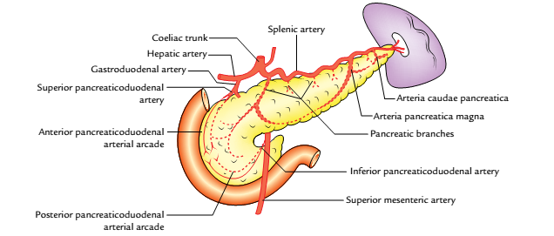
Arterial supply of the pancreas

Slide 30
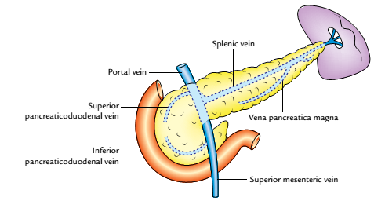
VENOUS DRAINAGE
The veins of the pancreas drain into (a) portal vein, (b) superior mesenteric vein, and (c) splenic vein.

Slide 31
NERVE SUPPLY
The sympathetic and parasympathetic nerve fibres reach the gland along its arteries from coeliac and superior mesenteric plexuses.
The sympathetic supply is vasomotor whereas the parasympathetic supply controls the pancreatic secretion.

Slide 32
LYMPHATIC DRAINAGE
The lymphatics from the pancreas follow the arteries and drain mainly into the following groups of lymph nodes:
Pancreaticosplenic nodes (main group).
Coeliac nodes.
Superior mesenteric nodes.
Pyloric nodes.

Slide 33
APPLIED ANATOMY
Carcinoma of the head of pancreas is common. It compresses the bile duct leading to persistent obstructive jaundice. It may press the portal vein or may involve the stomach due to close vicinity of these structures to the head of pancreas.
Acute pancreatitis is the acute inflammation of the pancreas. It occurs due to obstruction of pancreatic duct, ingestion of alcohol, viral infections (mumps), or trauma.

Slide 34


